Slide 1
Deep Learning Practice: Computer Vision Module
Kaushik Mitra
Electrical Engineering
IIT Madras

Slide 2
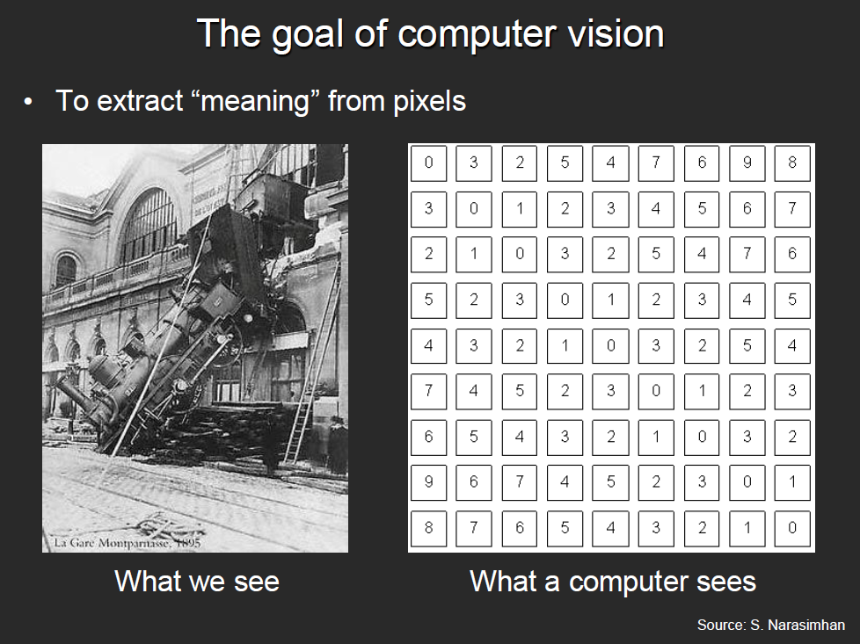

Slide 3
What kind of information can be extracted from an image?
Semantic information
Metric information

Slide 4
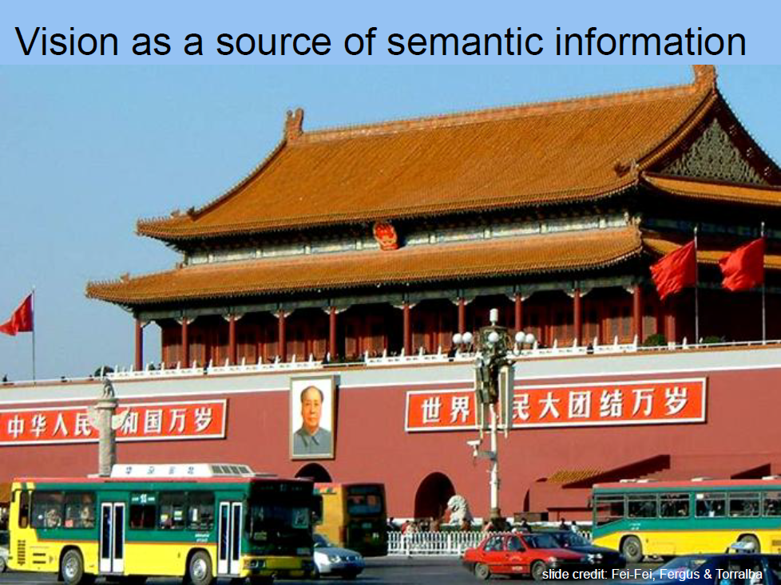

Slide 5
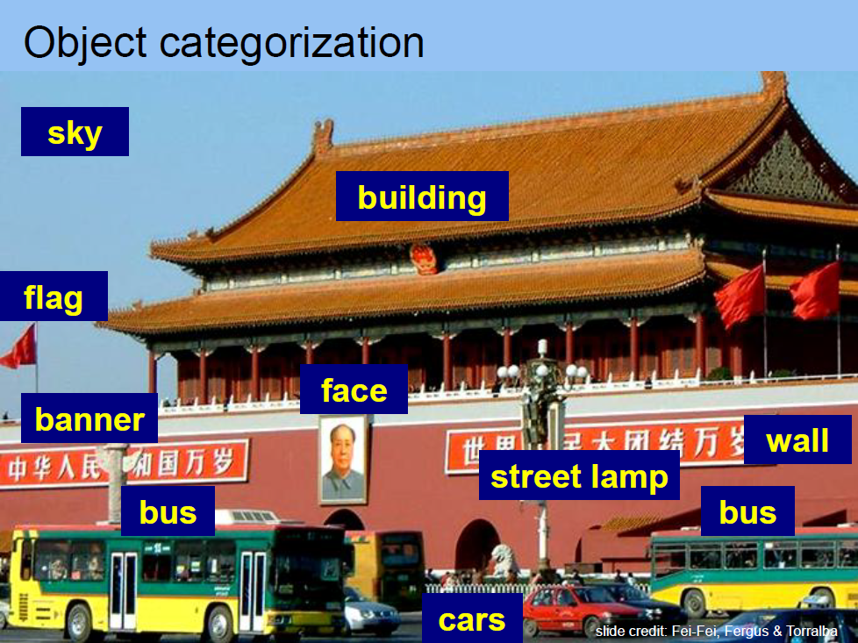

Slide 6
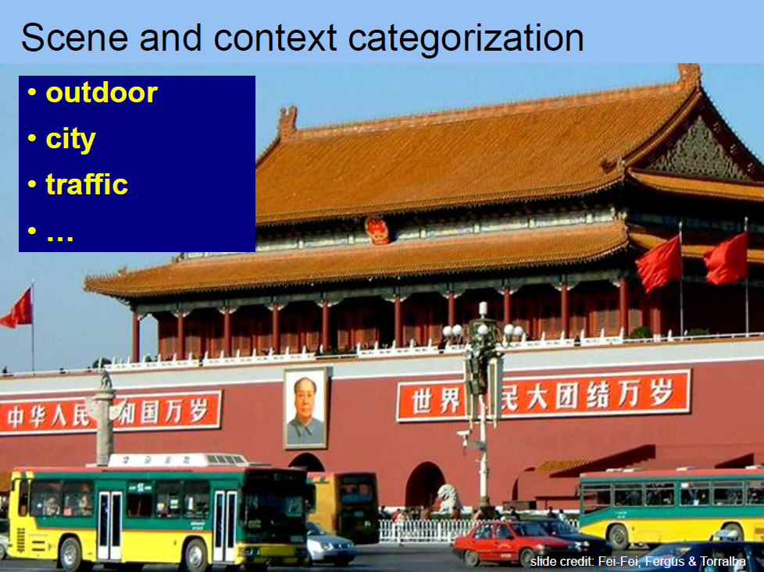

Slide 7
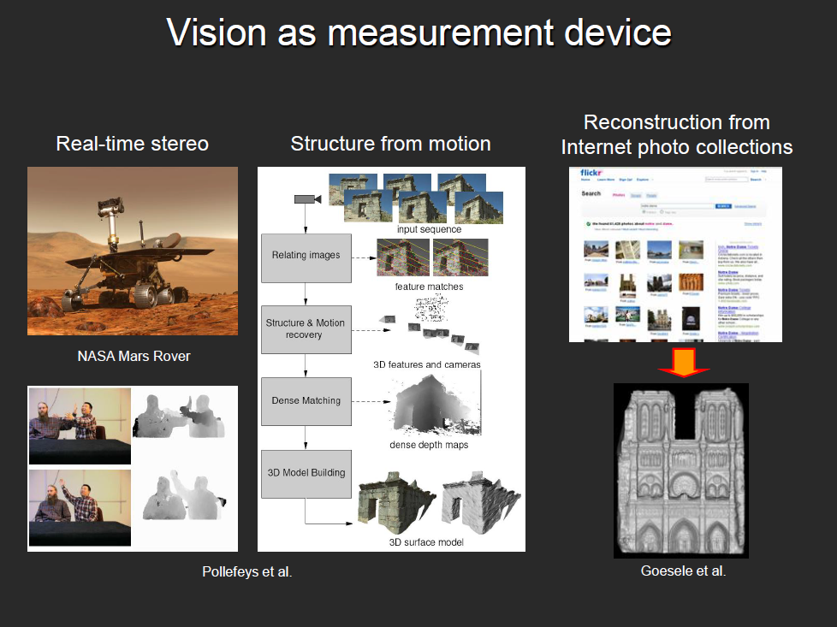

Slide 8
Semantic Computer Vision tasks

Slide 9
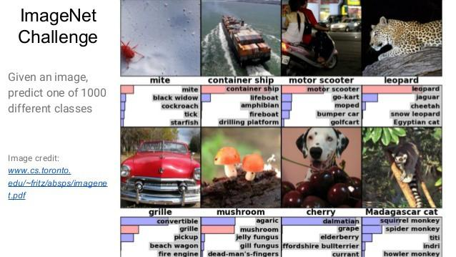
Object Recognition

Slide 10
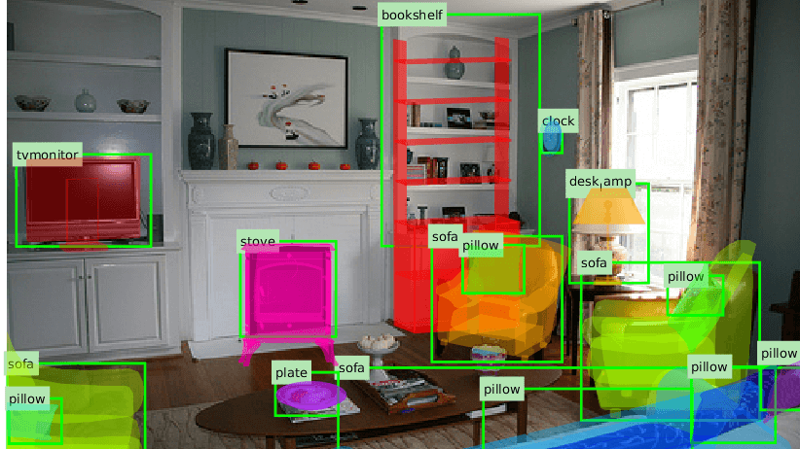

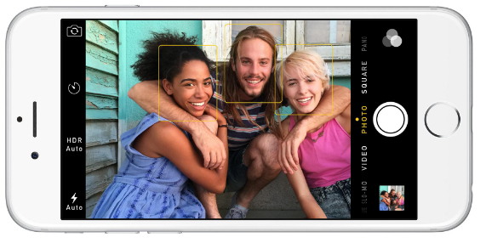
Object/face Detection (Recognition + Localization)
Image Source
You Only Look Once: Unified, Real-Time Object Detection

Slide 11
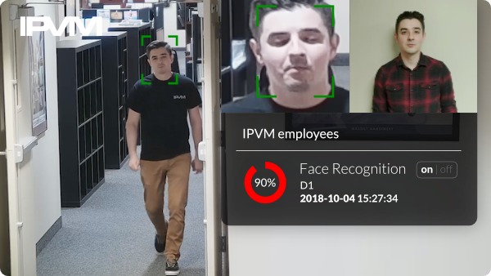
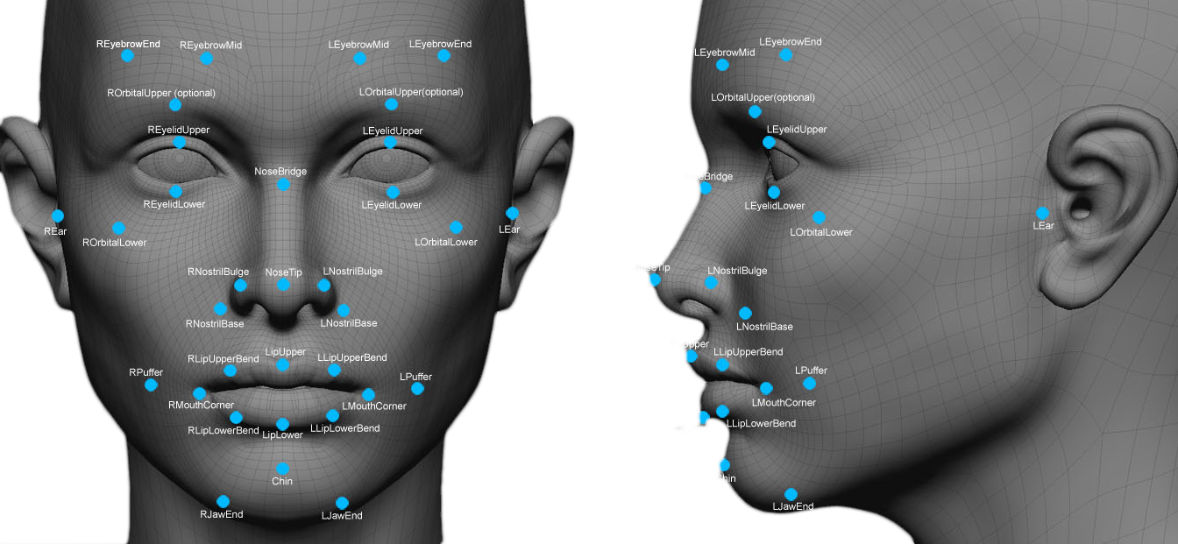
Face detection + Localization + Classification
Image Source
Image Source
Notes:
https://ipvm-uploads.s3.amazonaws.com/uploads/embedded_image/f74582bead7f238c61e05b74c191365eac8d248ed5591faf5cddf30683221eaa/c6a8744b-d6ff-4b4f-9c7b-89c1a8a4f5bb.jpg
https://www.rhombussystems.com/img/face-detection-recognition.png

Slide 12
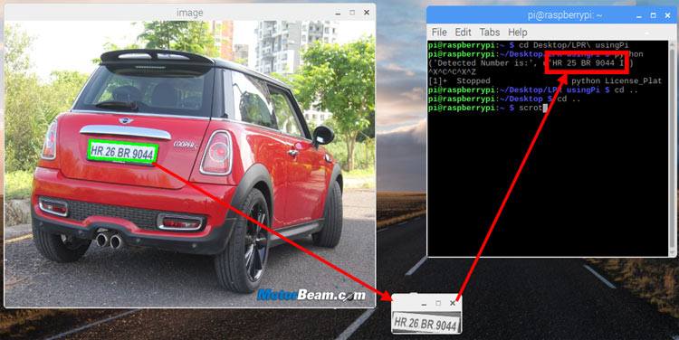
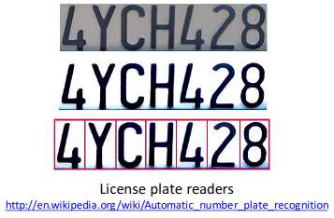
Number Plate Reader
Notes:
https://circuitdigest.com/sites/default/files/projectimage_mic/License-Plate-Recognition-using-Raspberry-Pi-and-OpenCV.jpg

Slide 13
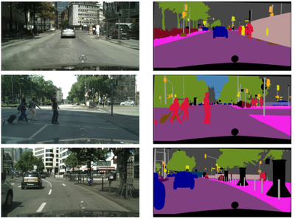
Image Segmentation
Notes:
https://beerensahu.files.wordpress.com/2019/02/image-4.png?w=810

Slide 14
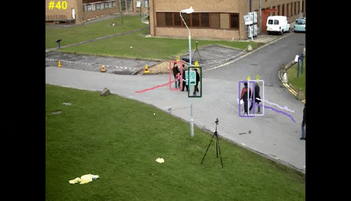
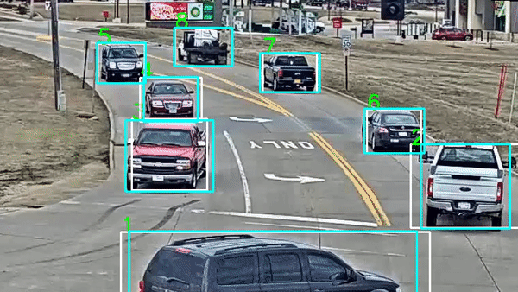
Object Tracking
DeepSORT: Deep Learning to track custom objects in a video
Image Source
Notes:
https://thumbs.gfycat.com/JoyousAdorableArrowcrab-small.gif

Slide 15
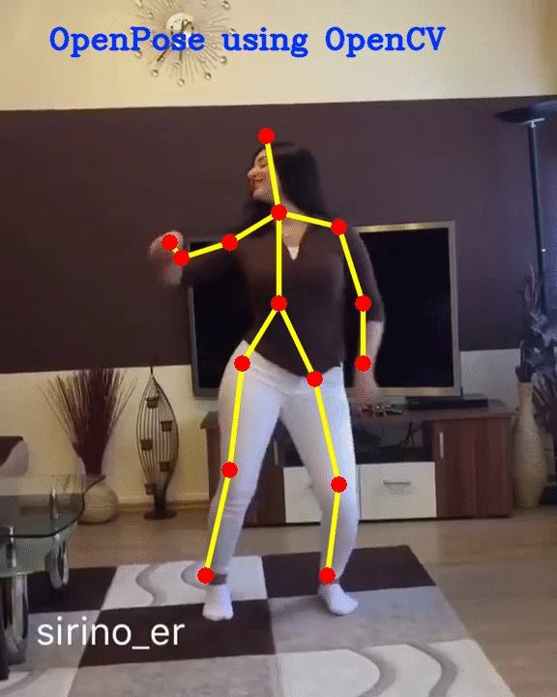
Pose estimation

Slide 16
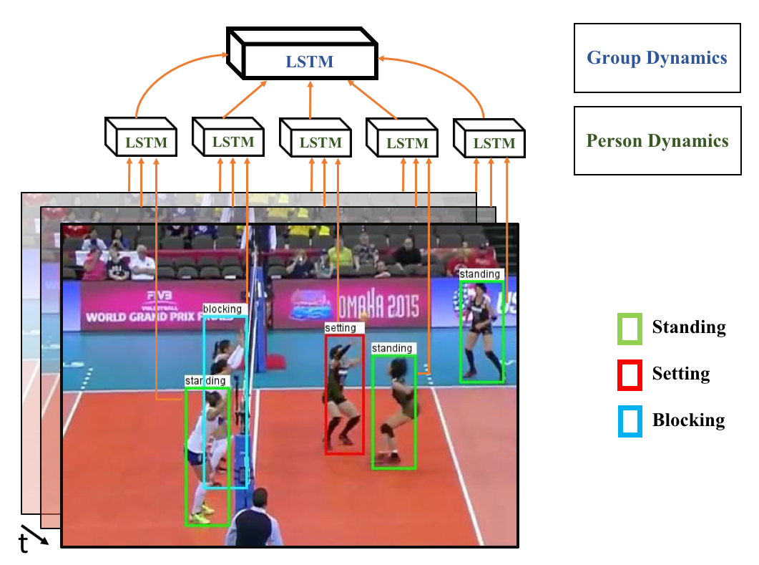
Activity
Recognition
Notes:
https://uwaterloo.ca/vision-image-processing-lab/sites/ca.vision-image-processing-lab/files/uploads/images/bow_framework.png

Slide 17
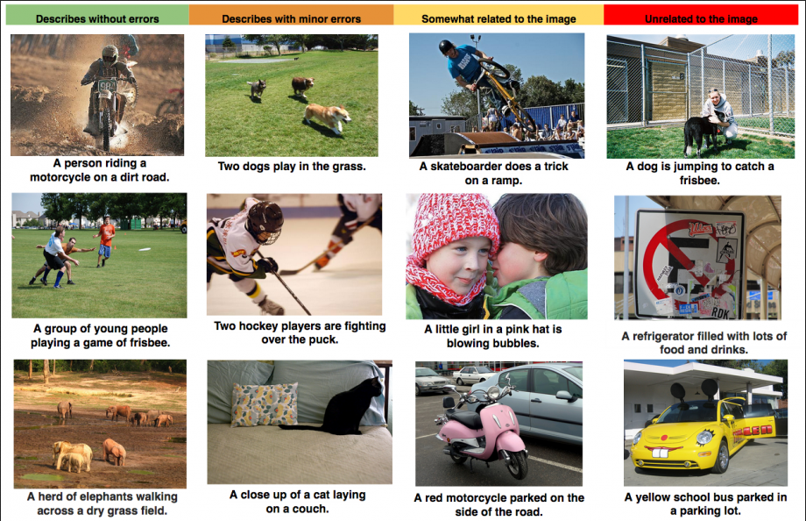
Image Captioning
Notes:
https://www.roboticstomorrow.com/images/upload/images/64580792.png

Slide 18
Geometric Computer Vision :
Vision for measurement

Slide 19
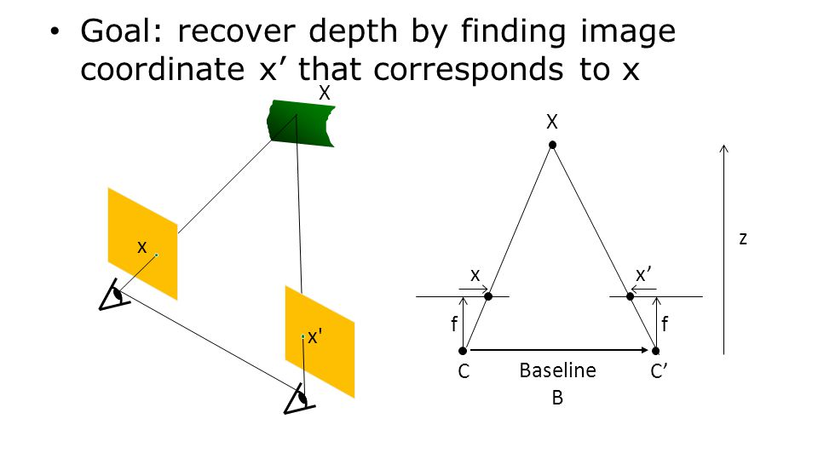
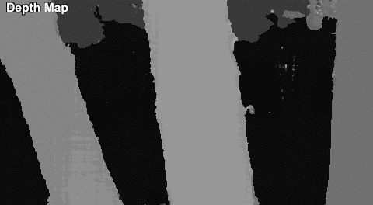
Depth from stereo
Source: Simon Jacobs

Slide 20
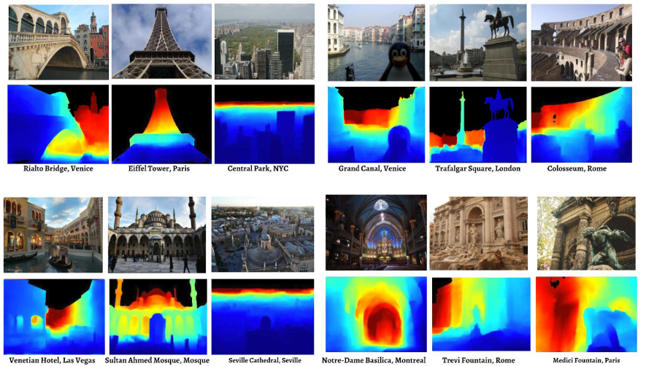
Depth from a single image
Courtesy Noah Snavely

Slide 21
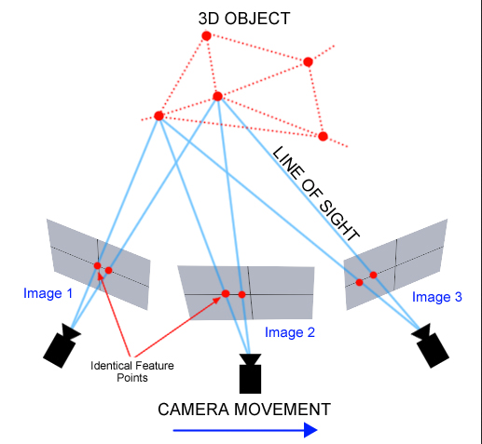
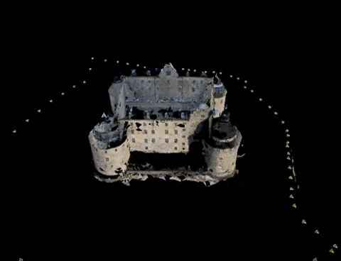
Structure From Motion
Source: Dr. Calle Olsson

Slide 22
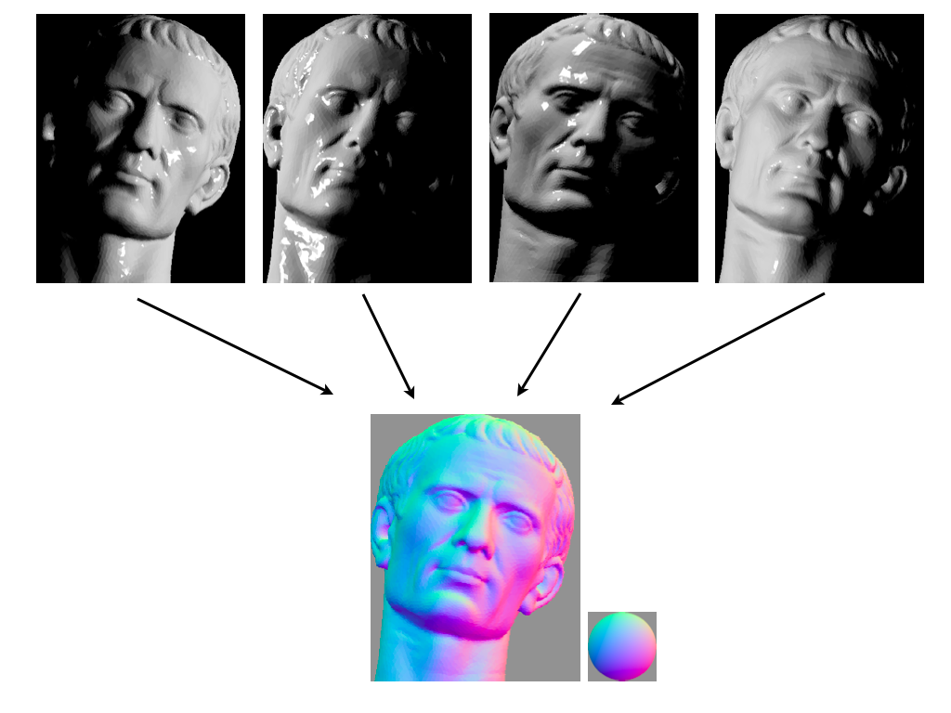
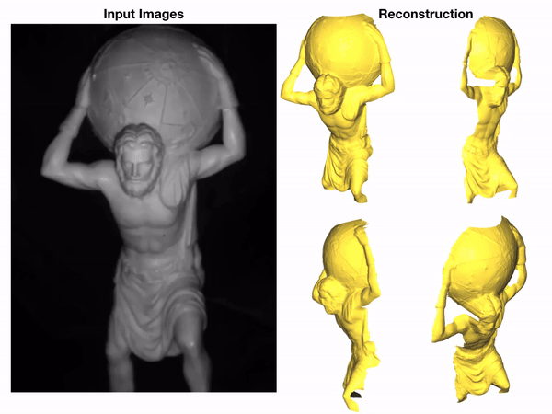
Photometric stereo
Courtesy Wikipedia
" Near-Light Photometric Stereo using Circularly Placed Point Light Sources "
Notes:
https://upload.wikimedia.org/wikipedia/commons/b/b5/Photometric_stereo.png

Slide 23
You just saw many examples of current systems.
But what challenges do they face ?

Slide 24
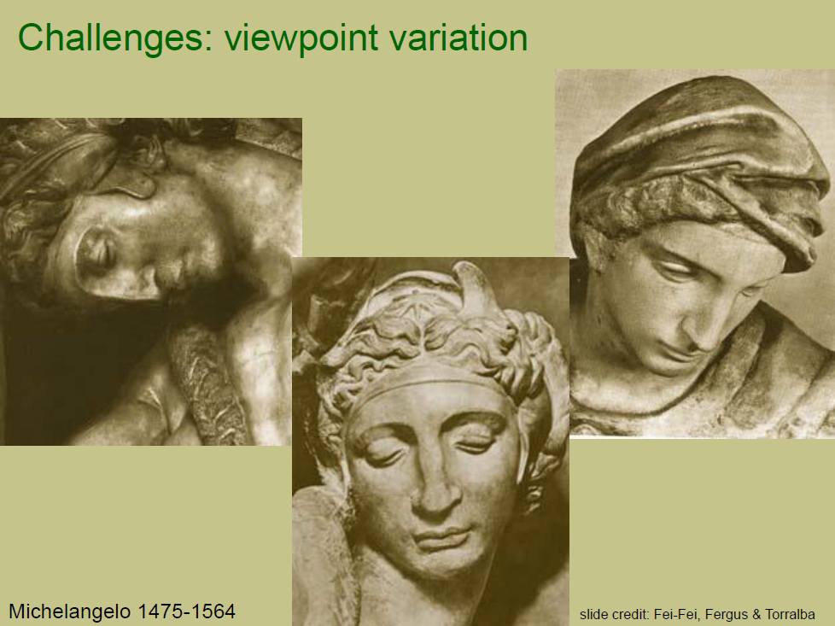

Slide 25
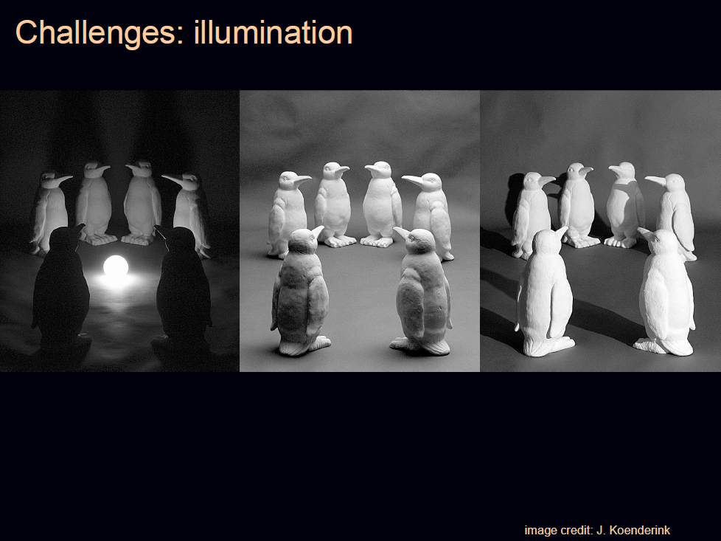

Slide 26
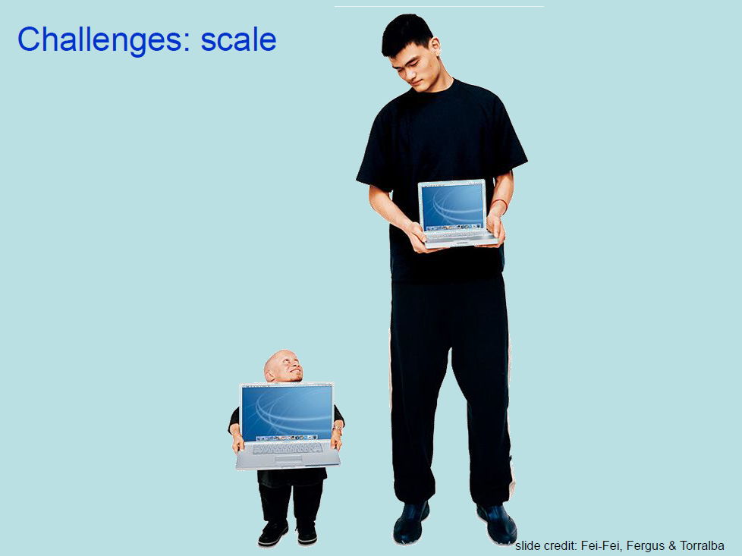

Slide 27
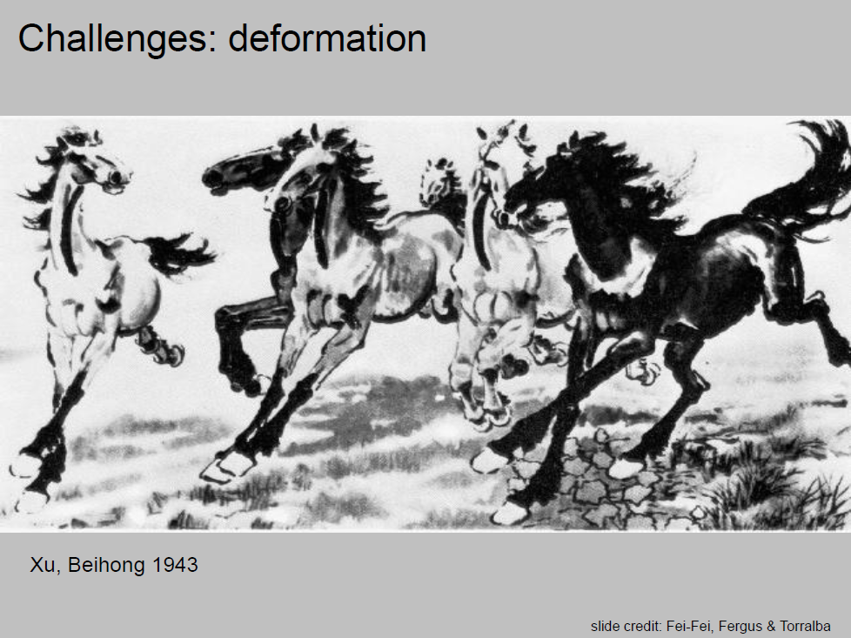

Slide 28
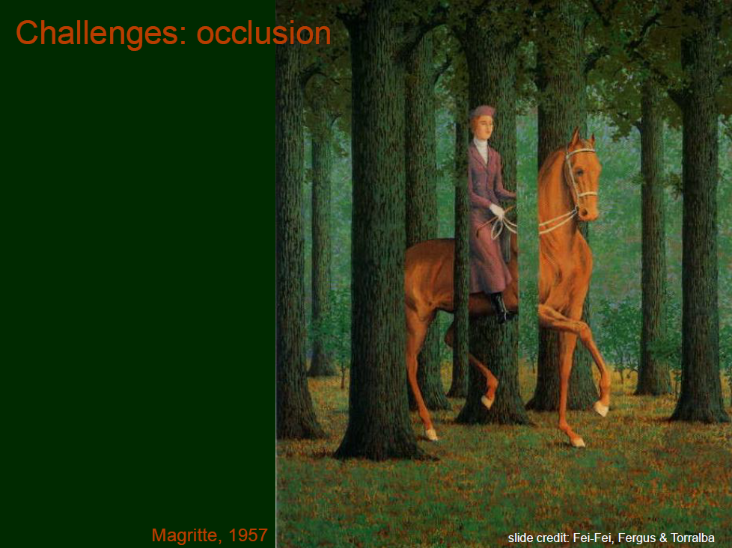

Slide 29
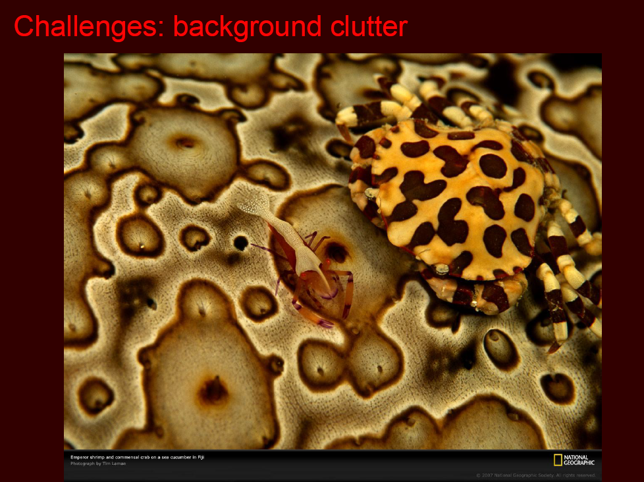

Slide 30
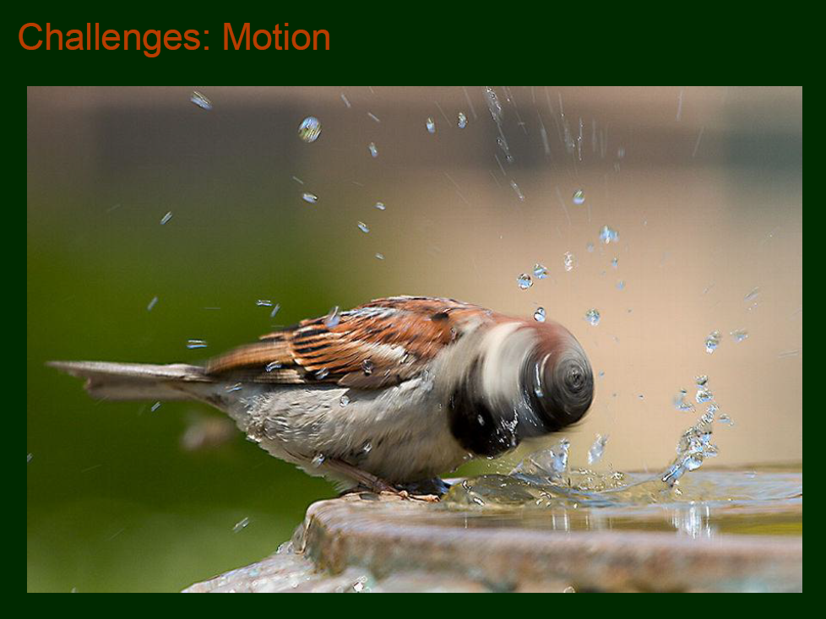

Slide 31
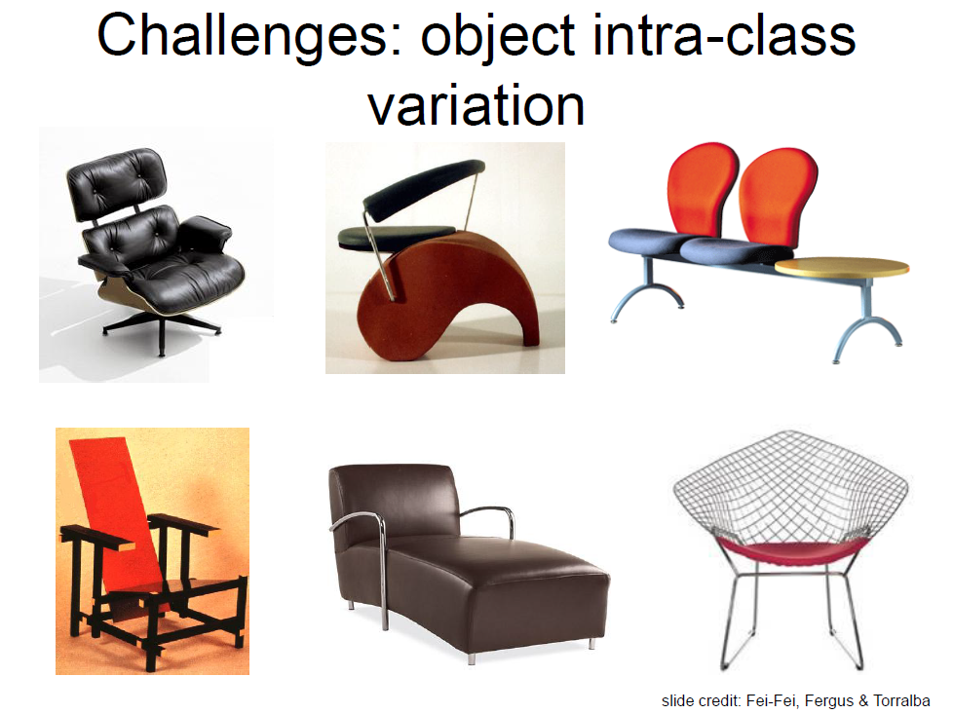

Slide 32
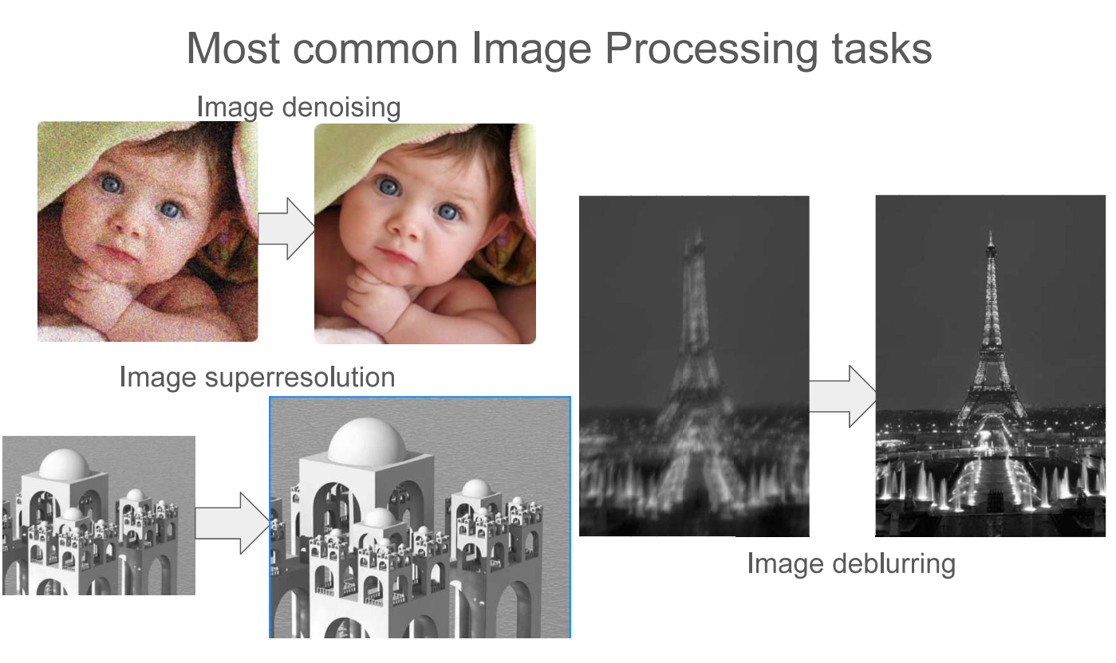
Our focus in this course
Object Recognition
Object Detection
Depth from Single Image
Image Pre-processing

Slide 33
Computer Vision via Deep Learning

Slide 34
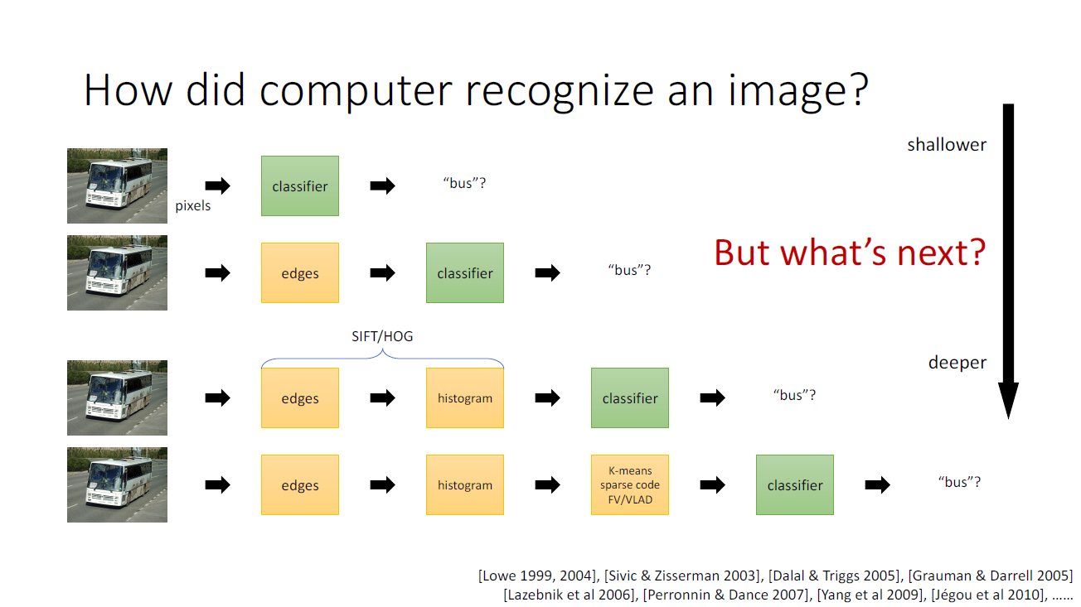
Slide credit: Kaiming he
Notes:
BoW

Slide 35
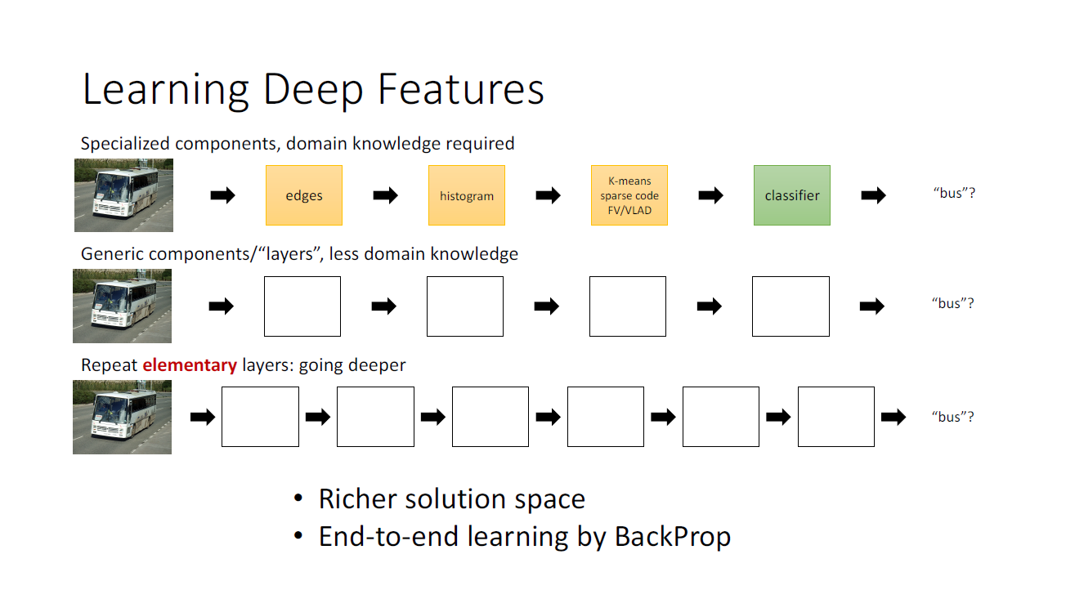
Slide credit: Kaiming he

Slide 36
Neural Networks

Slide 37
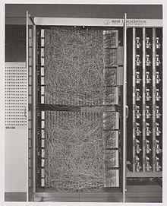
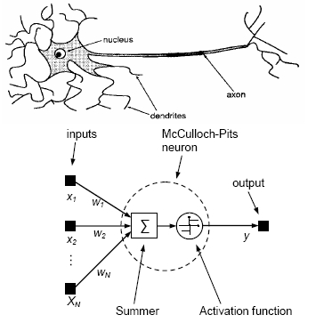
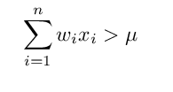
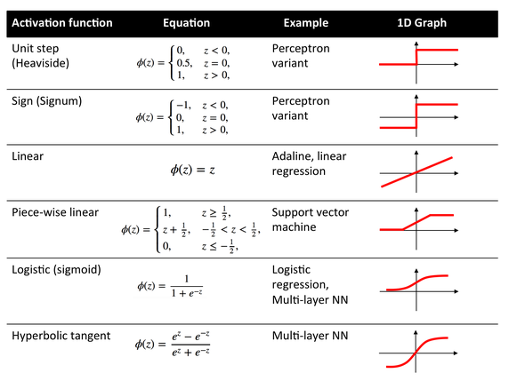
The Perceptron - Rosenblatt (1953)
Mark 1 perceptron for digit recognition

Slide 38
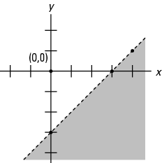
Perceptron - geometrical interpretation
, What does this inequality imply in 2D case?
Half plane
W^{T}x = μ
𝕏 | AND
(0, 0) | 0
(0, 1) | 0
(1, 0) | 0
(1, 1) | 1
x₂
(1, 1)
1
*Pic courtesy, cliffsnotes
0
1
x₁
Any function that is linearly separable can be
computed by a perceptron
Notes:
https://courses.cs.washington.edu/courses/csep573/11wi/lectures/22-nns.pdf
Half plane - https://www.cliffsnotes.com/study-guides/algebra/algebra-i/coordinate-geometry/linear-inequalities-and-half-planes

Slide 39
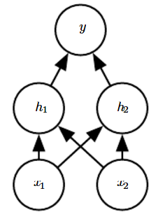
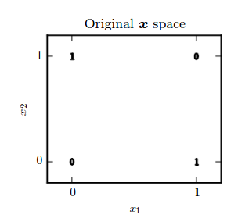
Perceptron - Limitations
Goal: learn the XoR function (f*)
𝕏 | f*
(0, 0) | 0
(0, 1) | 1
(1, 0) | 1
(1, 1) | 0
How to tackle this problem?
Can we use more than one line?
*Slide courtesy, Ian Goodfellow et al., deep learning book

Slide 40
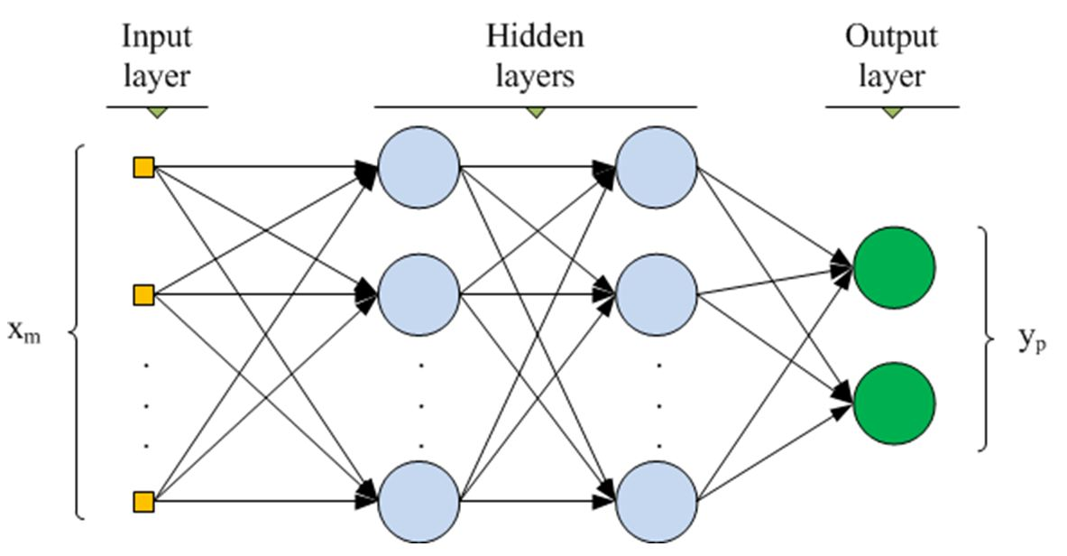
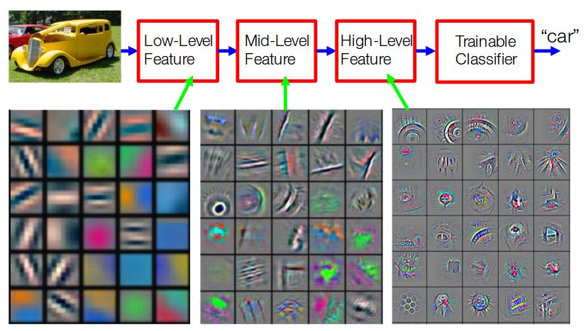
Multi-layer Perceptrons
L = (y’-y)²
V
W
U
h₁
h₂
Hidden layers increase abstraction
Figure courtesy, Yoshua Bengio and Yann Lecun
hence, better to have more hidden layers than a single layer with large number of neurons
Figure courtesy, Sancho course

Slide 41
Convolutional Neural Network

Slide 42
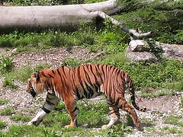
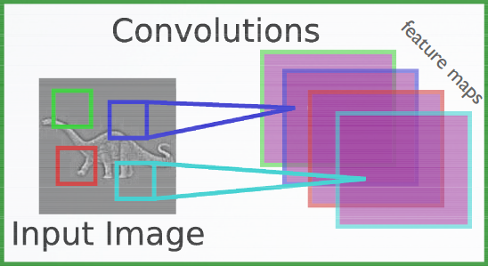
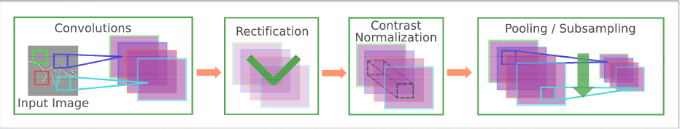

Convolutional Neural Networks (CNNs)
CNNs vs MLPs
Naively using MLP to classify 224x224x3 (~ 3 x 40,000) typical ImageNet image -> parameter explosion
Doesn’t exploit local spatial information
Can we build special neural nets for images exploiting
2D topology of pixels
Achieve invariance to translation ?
Category: tiger
ImageNet
Convolutional networks leverage these ideas,
Local connectivity
Parameter sharing
Pooling/ Subsampling
ReLu (rectifier) nonlinearity
*slide courtesy, Hugo Larochelle course on Neural networks
MLPs FC parameter explosion
Local processing (feature sharing)
Invariances (scale, translation) - convolution takes care of this
Feature abstraction - compositional

Slide 43
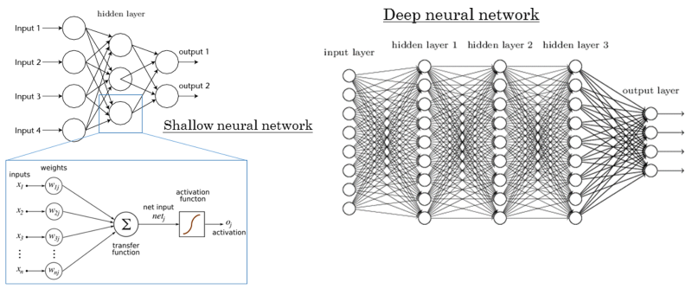
CNNs over Multi-layer neural networks (MLNN)
Multi-layer neural network
CNNs are multi-layer neural network with two constraints:
Local connectivity
Parameter sharing

Slide 44
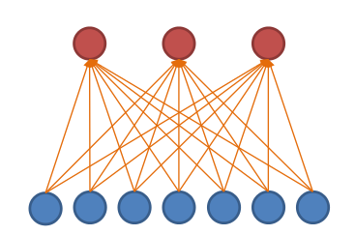

CNN: Local connectivity (LC)
Hidden layer (3 nodes)
Input layer (7 nodes)
MLNN ( 7 X 3 = 21 parameters)
MLNN-LC ( 3 X 3 = 9 parameters)
2.3X runtime and storage efficient.
In general for a level with m input and n output nodes and CNN-local connectivity of k nodes (k<m):
MLNN have
m x n parameters to store.
O(m x n) runtime
MLNN-LC have:
k x n parameters to store.
O(k x n) runtime

Slide 45


CNN: Parameter sharing (PS)
MLNN (21 parameters)
MLNN-LC ( 3 X 3 = 9 parameters)
2.3X runtime and storage efficient.
MLNN-LC-PS (3 parameters)
2.3X faster,
& 7X storage efficient.
In general for a level with m input and n output nodes and CNN-local connectivity of k nodes (k<m):
MLNN have
m x n parameters to store.
O(m x n) runtime
MLNN-LC have:
k x n parameters to store.
O(k x n) runtime
MLNN-LC-PS have:
k parameters to store.
O(k x n) runtime

Slide 46




CNN with multiple input channels
Channel 2
Single input channel
Two input channels

Slide 47


CNN with multiple output maps
Single input map
Two output maps

Slide 48

A generic level of CNN
Parameter sharing
Local connectivity
# input channels
# output maps

Slide 49
Different layers in CNN architecture (pooling, relu, etc.)

Slide 50

Different layers of CNN architecture

Slide 51

CNN: Convolutional layer
To reduce the number of weights (through local connectivity).
To provide spatial invariance (through parameter sharing).

Slide 52


Hyper parameters for convolutional layer.
Zero padding (to control input size spatially.)
Without padding (i.e., [0,0])
With padding [2,2]

Slide 53

Hyper parameters for convolutional layer.
2. Stride (to produce smaller output volumes spatially.)
Without stride (i.e., [1,1])
With stride [2,2]

Slide 54

Hyper parameters for convolutional layer.
Both padding and stride
Without padding and stride
With padding [1,1] & stride [2,2]

Slide 55
Different layers of CNN architecture

Slide 56

CNN: Pooling layer
To reduce the spatial size of the representation to reduce the amount of parameters and computation in the network.
Average pooling or L2 pooling can also be used, but not popular like max pooling.

Slide 57
Different layers of CNN architecture

Slide 58



Activation functions: Sigmoidal function
Sigmoids saturate and kill gradients (when the neuron’s activation saturates at either tail of 0 or 1).
0 ⇒ fails to update weights while back-prop.
Notes:
Sigmoids saturate and kill gradients. A very undesirable property of the sigmoid neuron is that when the neuron’s activation saturates at either tail of 0 or 1, the gradient at these regions is almost zero. Recall that during backpropagation, this (local) gradient will be multiplied to the gradient of this gate’s output for the whole objective. Therefore, if the local gradient is very small, it will effectively “kill” the gradient and almost no signal will flow through the neuron to its weights and recursively to its data. Additionally, one must pay extra caution when initializing the weights of sigmoid neurons to prevent saturation. For example, if the initial weights are too large then most neurons would become saturated and the network will barely learn.

Slide 59


Activation functions: Rectified Linear Unit (very popular).
6X improvement in convergence
tanh
ReLU
Advantage 1: Eliminate saturation and killing of gradients for positive inputs.
Advantage 2: Greatly accelerate convergence of SGD. (Krizhevsky et al. argued that this is due to its linear, non-saturating form.)
Advantage 3: tanh/sigmoid neurons involve expensive operations (exponentials, etc.), whereas ReLU can be implemented by simply thresholding activations at zero.
Notes:
t was found to greatly accelerate (e.g. a factor of 6 in Krizhevsky et al.) the convergence of stochastic gradient descent compared to the sigmoid/tanh functions. It is argued that this is due to its linear, non-saturating form.
(+) Compared to tanh/sigmoid neurons that involve expensive operations (exponentials, etc.), the ReLU can be implemented by simply thresholding a matrix of activations at zero.

Slide 60
Different layers of CNN architecture

Slide 61


Flattening, fully connected (FC) layer and softmax
Class probabilities
Flattening
Vectorization (converting M X N X D tensor to a MND X 1 vector).
FC layer
Multilayer perceptron.
Generally used in final layers to classify the object.
Role of a classifier.
Softmax
Fully connected
Softmax layer
Normalize output as discrete class probabilities.

Slide 62

A CNN Example

Slide 63
What we covered today
Our focus in this course
Object Recognition
Object Detection
Depth from single image
Image pre-processing
Advantage of CNN over MLP
Local connectivity
Parameter sharing
Efficient runtime and storage
Different layers in CNN
Convolutional layer
ReLU
Pooling
Fully connected layer

